Slide 1


Kaie
2021-10-09

Slide 2

Outline
Executive Summary
Introduction
Methodology
Results
Conclusion
Appendix

Slide 3
Executive Summary
Our methodologies
Ask a good question;
Focus on the questions;
Clean data;
Tell a good story.
Summary of all results
Falcon 9 first stage will land successfully;
Success rate increased year by year;

Slide 4
Introduction
In this project, we will predict if the Falcon 9 first stage will land successfully. SpaceX advertises Falcon 9 rocket launches on its website with a cost of 62 million dollars; other providers cost upward of 165 million dollars each, much of the savings is because SpaceX can reuse the first stage. Therefore if we can determine if the first stage will land, we can determine the cost of a launch. This information can be used if an alternate company wants to bid against SpaceX for a rocket launch.
So, our good question is Whether the Falcon 9 first stage will land successfully.

Slide 5


Slide 6
Methodology
Executive Summary
Data collection methodology:
Make a request from the SpaceX API;
Scrap records from Wikipedia.
Perform data wrangling
Perform exploratory data analysis (EDA) using visualization and SQL
Perform interactive visual analytics using Folium and Plotly Dash
Perform predictive analysis using classification models
Use many classification models to train and predict;
Choose the best one.

Slide 7
Ipynb Files on Github
Data Collection – SpaceX API
Data Collection – Scraping
Data Wrangling
EDA with Data Visualization
EDA with SQL
Predictive Analysis

Slide 8


Slide 9
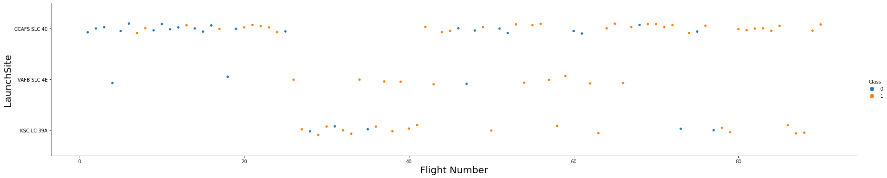
Flight Number vs. Launch Site

Slide 10
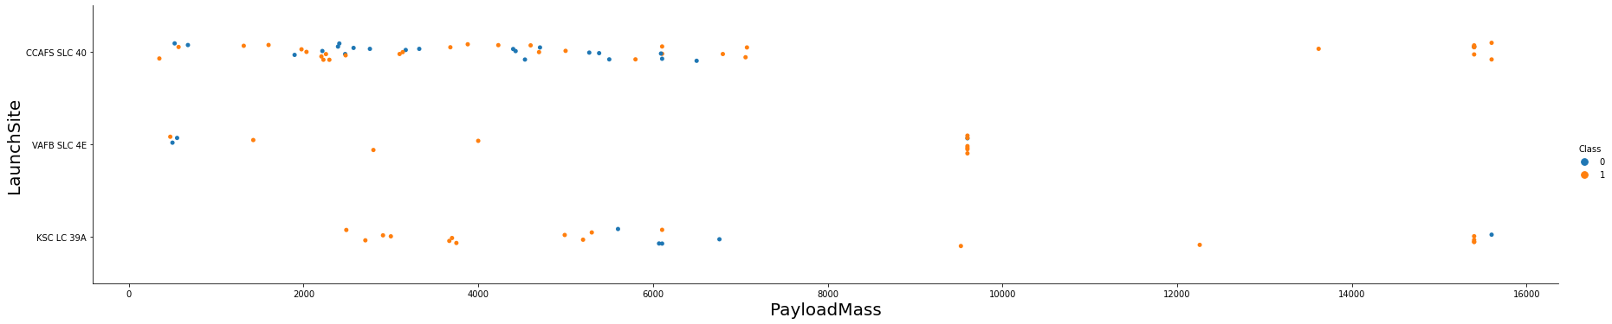
Payload vs. Launch Site

Slide 11
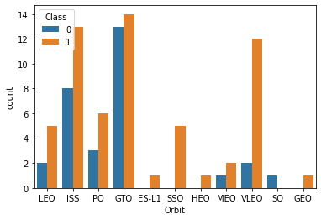
Success Rate vs. Orbit Type

Slide 12
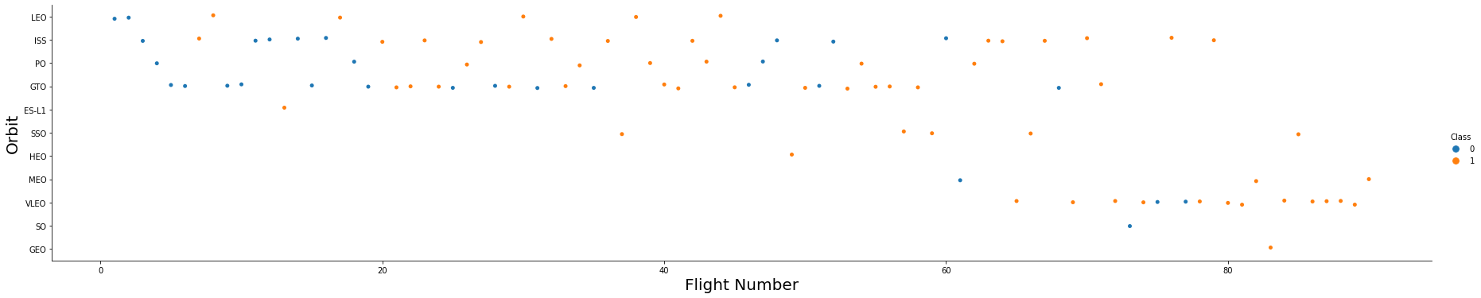
Flight Number vs. Orbit Type

Slide 13
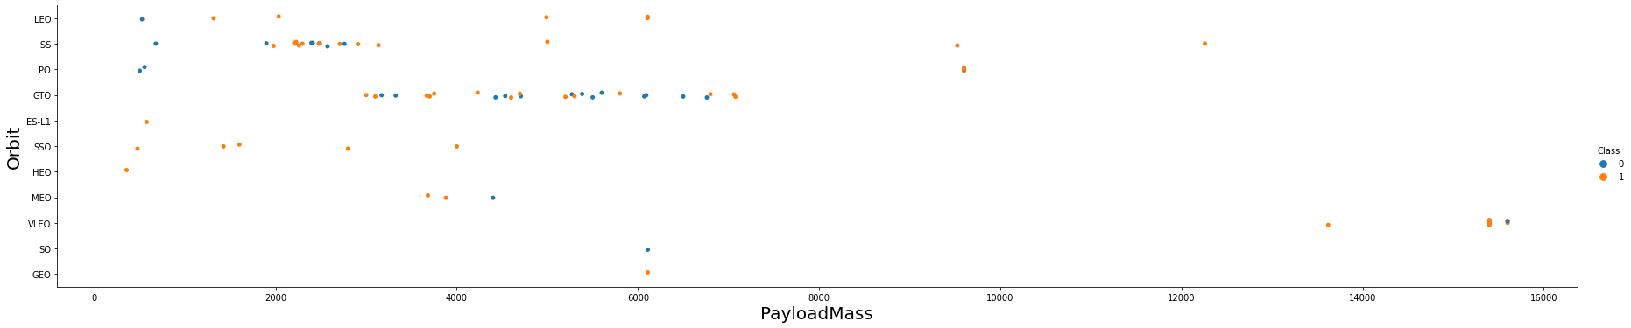
Payload vs. Orbit Type

Slide 14
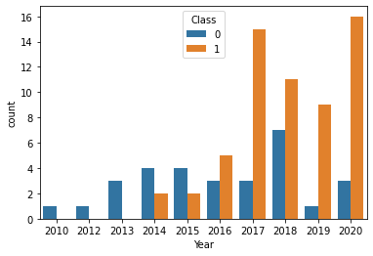
Launch Success Yearly Trend

Slide 15
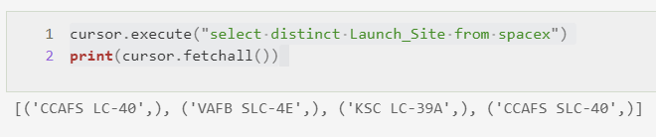
All Launch Site Names

Slide 16
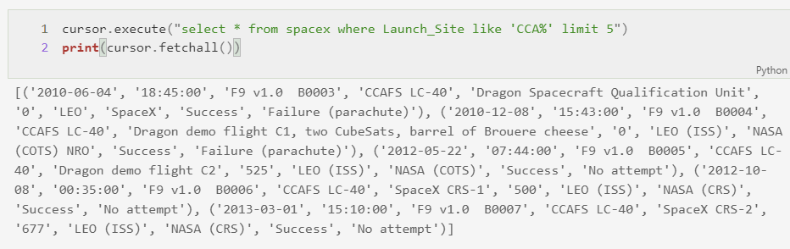
Launch Site Names Begin with 'CCA'

Slide 17
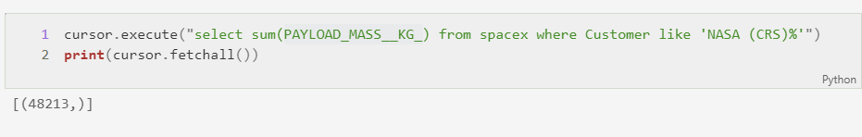
Total Payload Mass

Slide 18
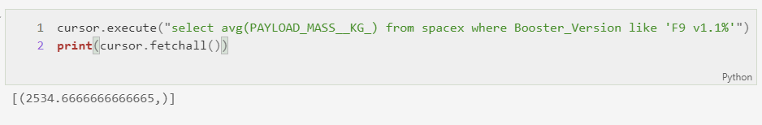
Average Payload Mass by F9 v1.1

Slide 19
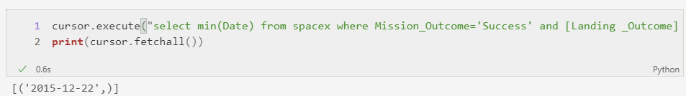
First Successful Ground Landing Date

Slide 20
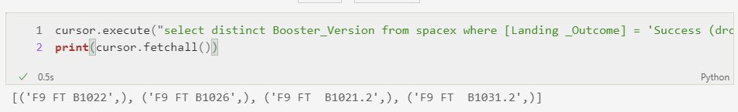
Successful Drone Ship Landing with Payload between 4000 and 6000

Slide 21
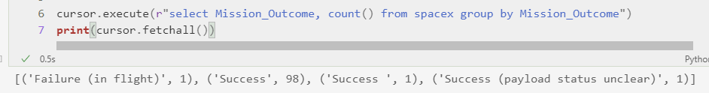
Total Number of Successful and Failure Mission Outcomes

Slide 22
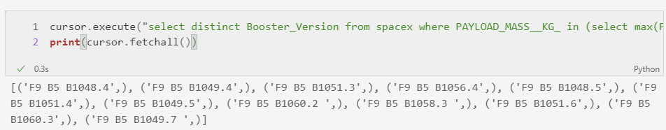
Boosters Carried Maximum Payload

Slide 23
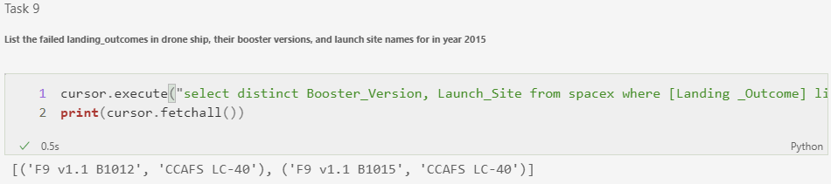
2015 Launch Records

Slide 24
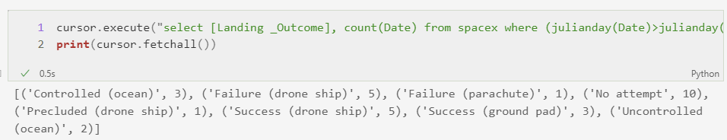
Rank Landing Outcomes Between 2010-06-04 and 2017-03-20

Slide 25


Slide 26
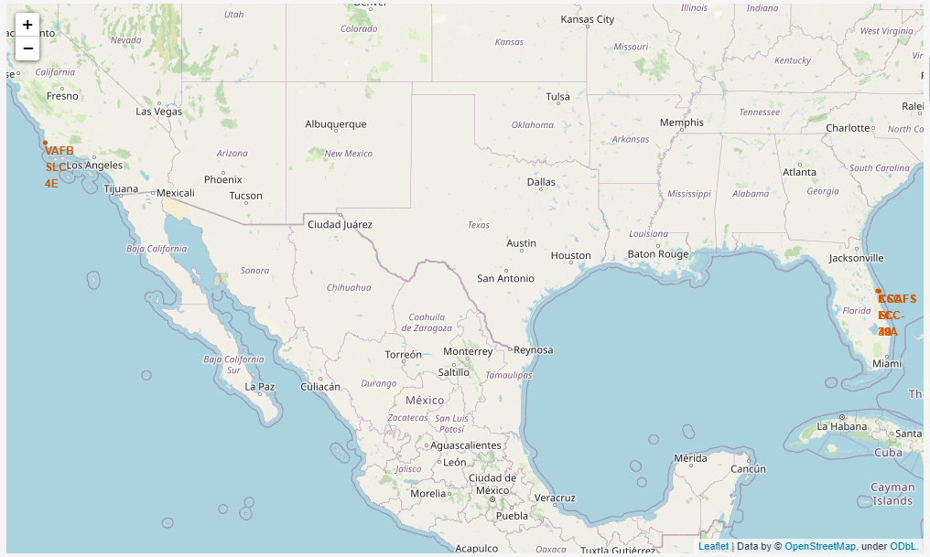
Launch sites

Slide 27
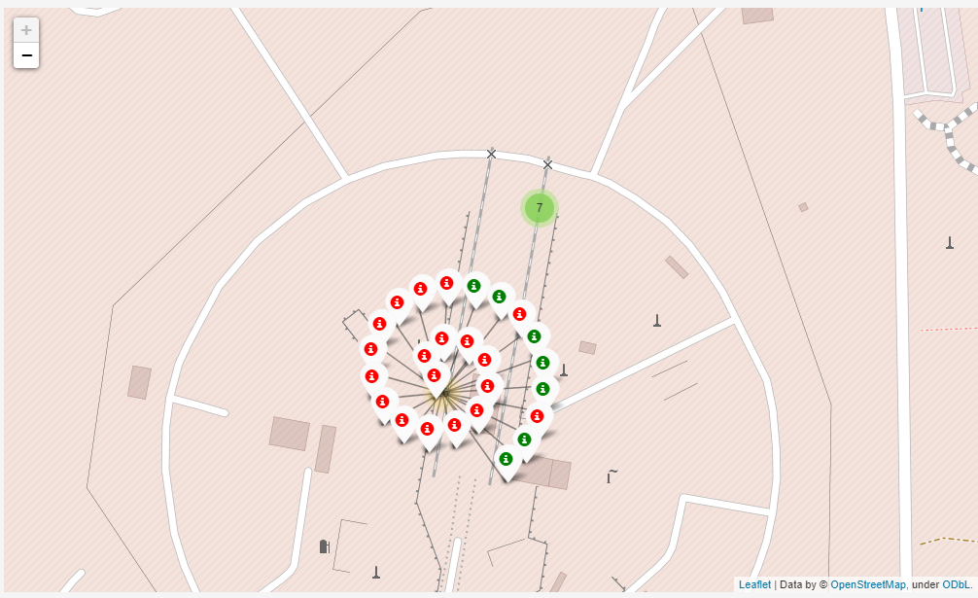
Successful / Failed launches Map

Slide 28
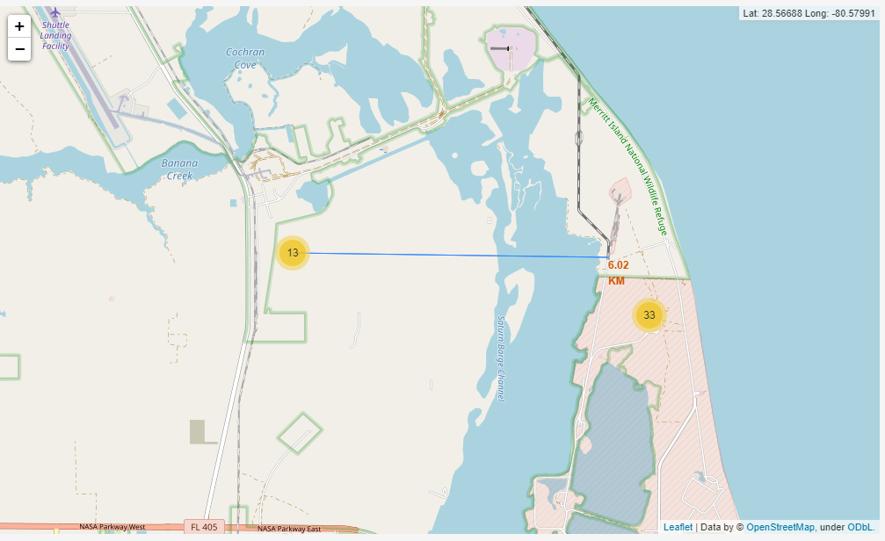
Distance Map

Slide 29


Slide 30
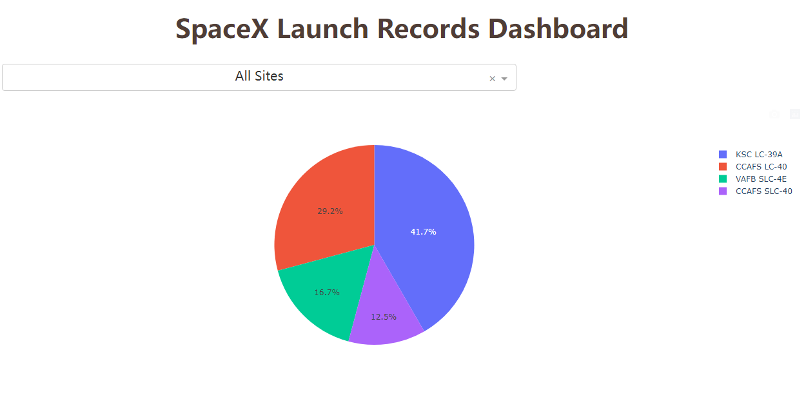
All sites

Slide 31
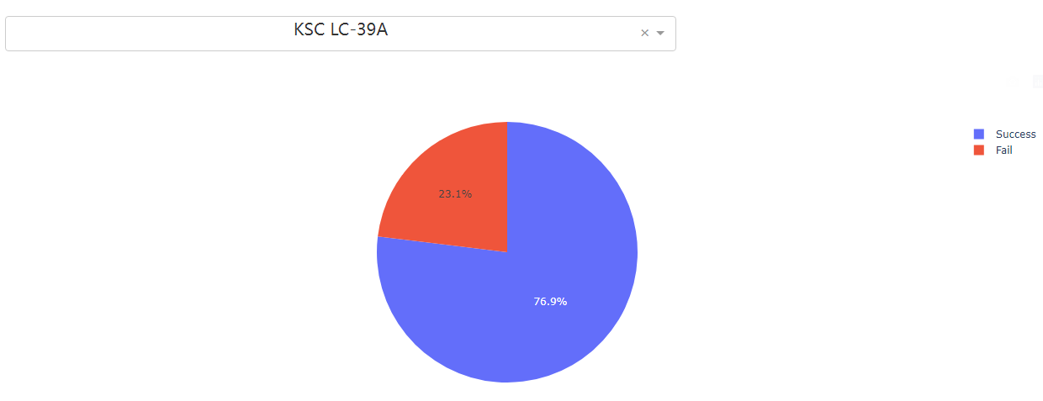
Highest launch success ratio

Slide 32
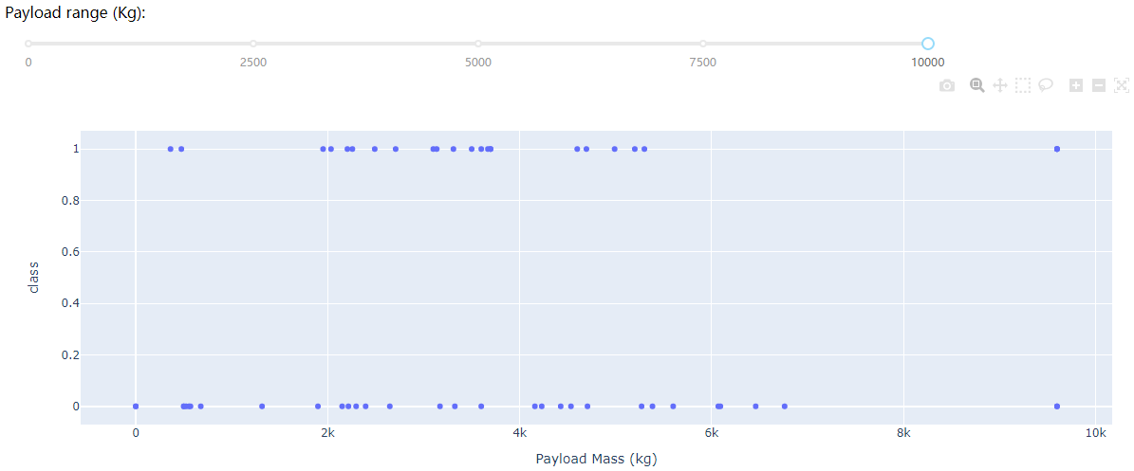
Payload vs. Launch Outcome

Slide 33


Slide 34
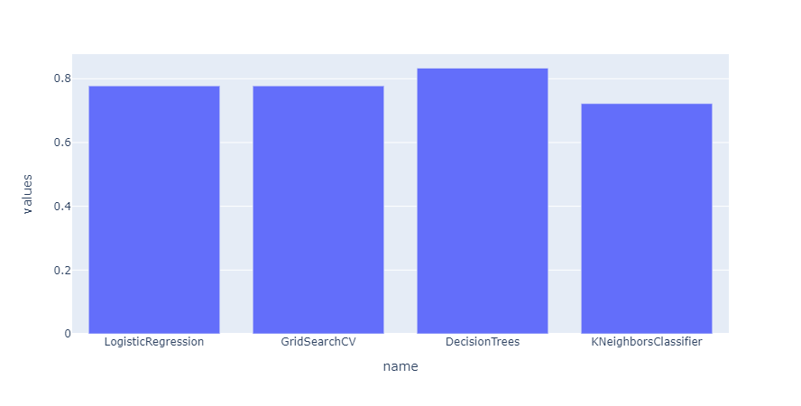
Classification Accuracy

Slide 35
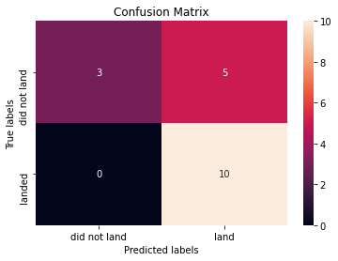
Confusion Matrix

Slide 36
Conclusions
Falcon 9 first stage will land successfully;
Success rate increased year by year;

Slide 37


